Slide 1
Project C
Calculate Score of Smart 1 test.

Slide 2
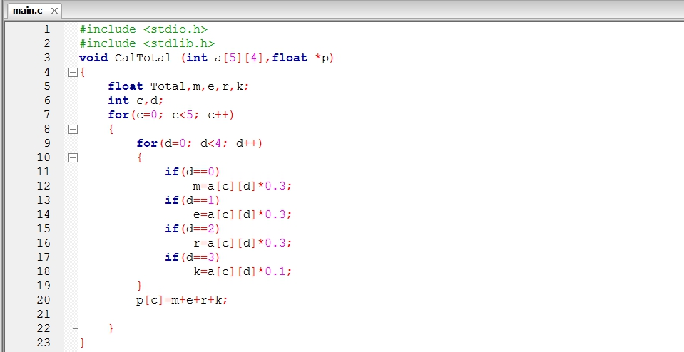
Function void (1)
Set for calculate total score.

Slide 3
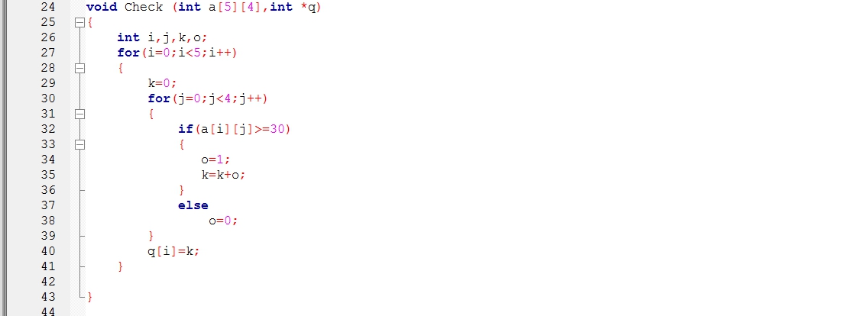
Function void (2)
Set for check the score when the user type over score.

Slide 4
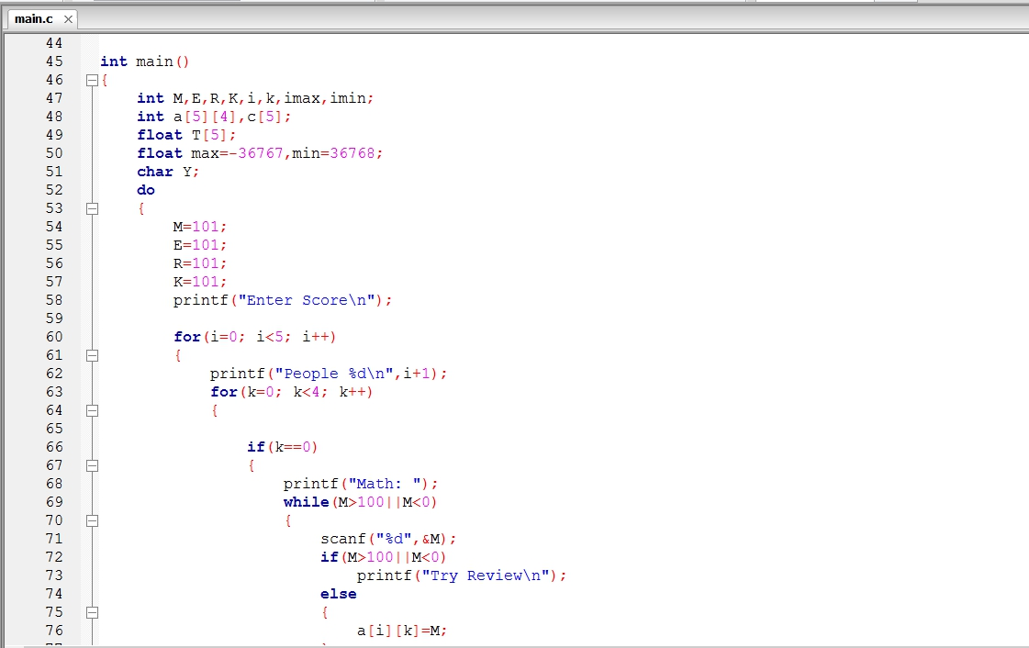
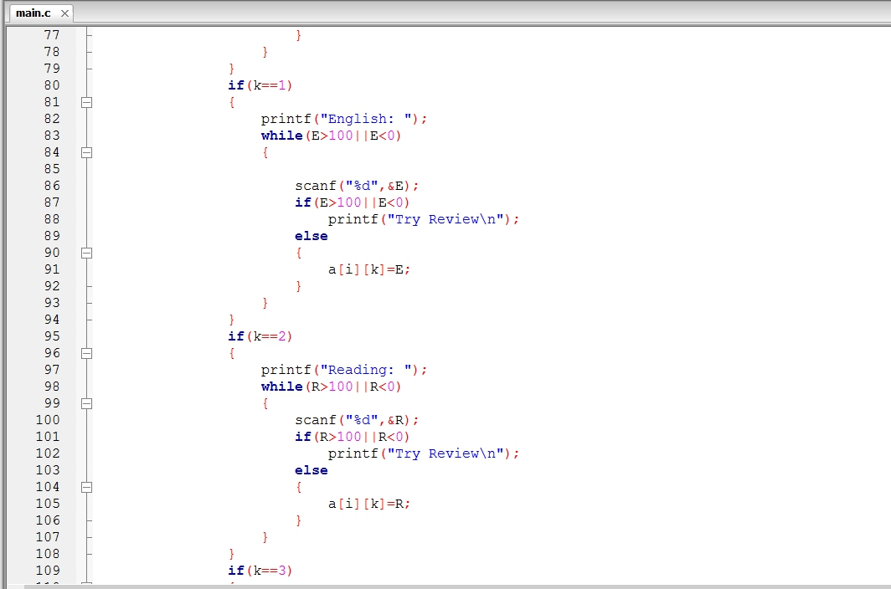
Main
In int main set program can calculate for 5 people .

Slide 5
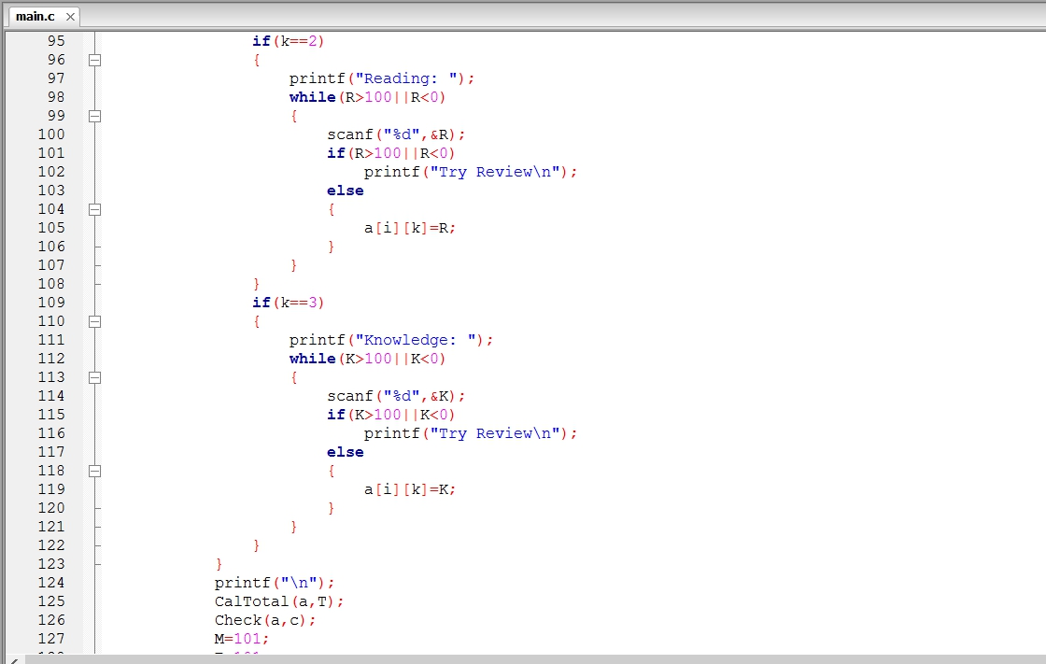
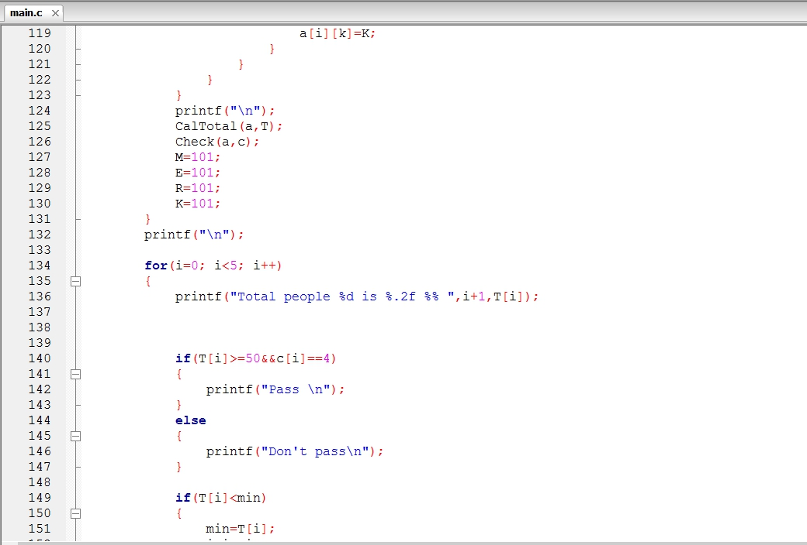
Main(2)

Slide 6
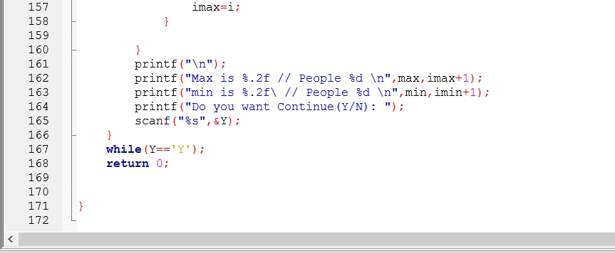
Main (3)

Slide 7
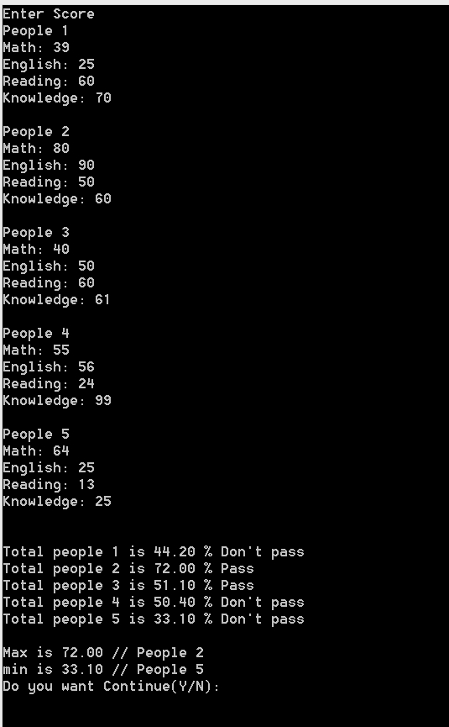
Run Program
If you input the score altogether, The program will operate properly.
And them will show who has the most scores, who pass the exam.

Slide 8
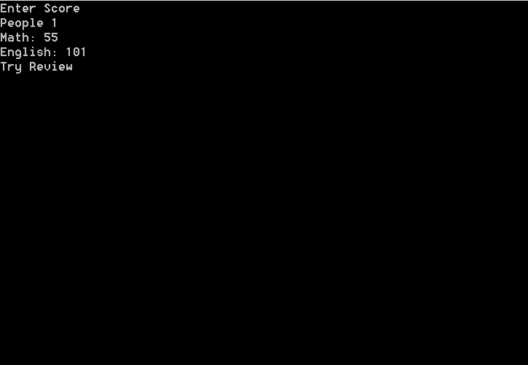
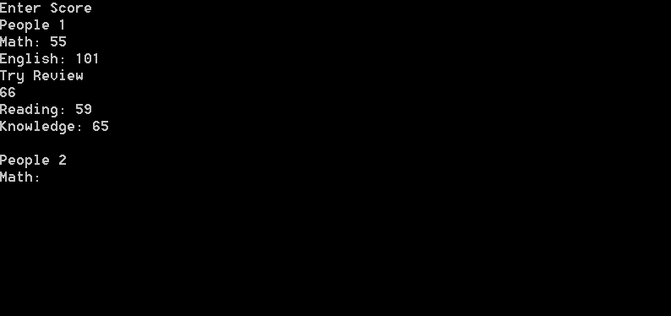
Run Program
If you input wrong score or over score
The program will Type “Try Review” and then you must input score again
When you input correct scores the program will continue to run.

